Slide 1
Module 7.11 DNS Security

Slide 2
Hierarchical Naming in DNS
unnamed root
com
edu
org
ac
uk
zw
arpa
generic domains
country domains
bar
ac
in-
addr
west
east
cam
12
foo
my
usr
34
my.east.bar.edu
usr.cam.ac.uk
56
12.34.56.0/24

Slide 3
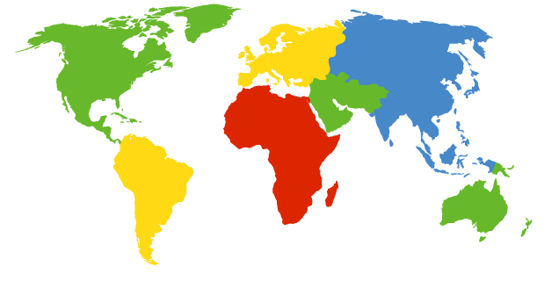
DNS Root Servers
13 root servers (see http://www.root-servers.org/)
Labeled A through M
A Verisign, Dulles, VA
C Cogent, Herndon, VA (also Los Angeles)
D U Maryland College Park, MD
G US DoD Vienna, VA
H ARL Aberdeen, MD
J Verisign, ( 11 locations)
K RIPE London (+ Amsterdam, Frankfurt)
I Autonomica, Stockholm (plus 3 other locations)
E NASA Mt View, CA
F Internet Software C. Palo Alto, CA (and 17 other locations)
m WIDE Tokyo
B USC-ISI Marina del Rey, CA
L ICANN Los Angeles, CA

Slide 4
DoS attacks on DNS Availability
Feb. 6, 2007
Botnet attack on the 13 Internet DNS root servers
Lasted 2.5 hours
None crashed, but two performed badly:
g-root (DoD), l-root (ICANN)
Most other root servers use anycast

Slide 5
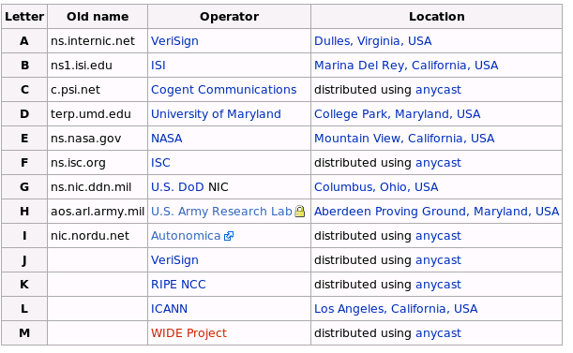
Defense: Replication and Caching
source: wikipedia

Slide 6
Denial-of-Service Attacks on Hosts
×40 amplification
DNS Query SrcIP: DoS Target
(60 bytes)
DNS Response
(3000 bytes)
DNS Server
DoS Source
DoS Target
580,000 open resolvers on Internet (Kaminsky-Shiffman’06)

Slide 7

Preventing Amplification Attacks
attacker
ip spoofed packets
open
amplifier
replies
prevent
ip spoofing
disable
open amplifiers
victim

Slide 8
DNS Integrity and the TLD Operators
If domain name doesn’t exist, DNS should return NXDOMAIN (non-existant domain) msg
Verisign instead creates wildcard records for all .com and .net names not yet registered
September 15 – October 4, 2003
Redirection for these domain names to Verisign web portal: “to help you search”
And serve you ads…and get “sponsored” search
Verisign and online advertising companies make $$

Slide 9
DNS Integrity: Cache Poisoning
Was answer from an authoritative server?
Or from somebody else?
DNS cache poisoning
Client asks for www.evil.com
Nameserver authoritative for www.evil.com returns additional section for (www.cnn.com, 1.2.3.4, A)
Thanks! I won’t bother check what I asked for

Slide 10
DNS Integrity: DNS Hijacking
To prevent cache poisoning, client remembers:
The domain name in the request
A 16-bit request ID (used to demux UDP response)
DNS hijacking
16 bits: 65K possible IDs
What rate to enumerate all in 1 sec? 64B/packet
64*65536*8 / 1024 / 1024 = 32 Mbps
Prevention: also randomize DNS source port
Kaminsky attack: this source port… wasn’t random
http://unixwiz.net/techtips/iguide-kaminsky-dns-vuln.html

Slide 11
Let’s strongly believe the answer! Enter DNSSEC
DNSSEC protects against data spoofing and corruption
DNSSEC also provides mechanisms to authenticate servers and requests
DNSSEC provides mechanisms to establish authenticity and integrity

Slide 12
PK-DNSSEC (Public Key)
The DNS servers sign the hash of resource record set with its private (signature) keys
Public keys can be used to verify the SIGs
Leverages hierarchy:
Authenticity of name server’s public keys is established by a signature over the keys by the parent’s private key
In ideal case, only roots’ public keys need to be distributed out-of-band

Slide 13
Verifying the Tree
Question: www.cnn.com ?
. (root)
dns.cs.princeton.edu
www.cnn.com A ?
src.cs.princeton.edu
ask .com server
SIG (ip addr and PK of .com server)
resolver
stub
resolver
www.cnn.com A ?
xxx.xxx.xxx.xxx
www.cnn.com A ?
.com
transaction
signatures
ask cnn.com server
SIG (ip addr and PK of cnn.com server)
add to cache
www.cnn.com A ?
SIG (xxx.xxx.xxx.xxx)
cnn.com

Slide 14
Conclusions
Security at many layers
Application, transport, and network layers
Customized to the properties and requirements
Exchanging keys
Public key certificates
Certificate authorities vs. Web of trust
Next time
Interdomain routing security
Learn more: Next Lecture

Slide 15
Lecture 7: Network Security
Total 6 Modules on basic Cryptography and network security
Module 7.1: Basic Cryptography
Module 7.2: Public Key Crypto
Module 7.3: RSA Public Key Crypto System
Module 7.4: Digital Signatures and Hash Functions
Module 7.5: Public Key Distribution
Module 7.6: Real World Protocols
Module 7.7: Network Security – terminologies
Module 7.8: Email Security, Certificates
Module 7.9: TLS
Module 7.10 IPSEC
Module 7.11: DNS-SEC

